Slide 1
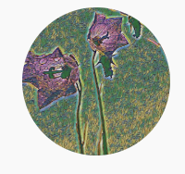
Performance Measures of Binary Classifiers

Slide 2
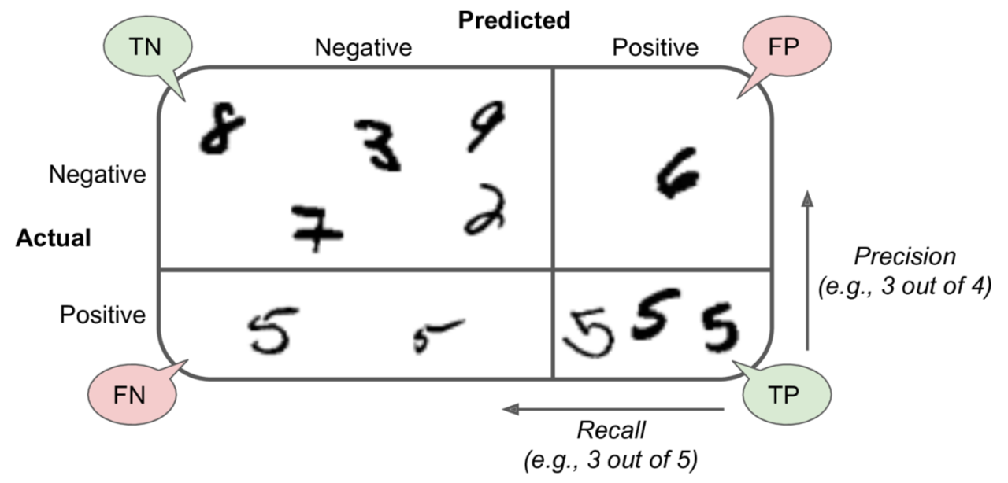

Chapter 3 (O'Reilly) of Hands-On ML

Slide 3
Prescision and Recall
Chapter 3 (O'Reilly) of Hands-On ML

Slide 4
Prescision and Recall
PRECISION = TP / (TP + FP)
Chapter 3 (O'Reilly) of Hands-On ML

Slide 5
Prescision and Recall
RECALL = TP / P
PRECISION = TP / (TP + FP)
Chapter 3 (O'Reilly) of Hands-On ML

Slide 6
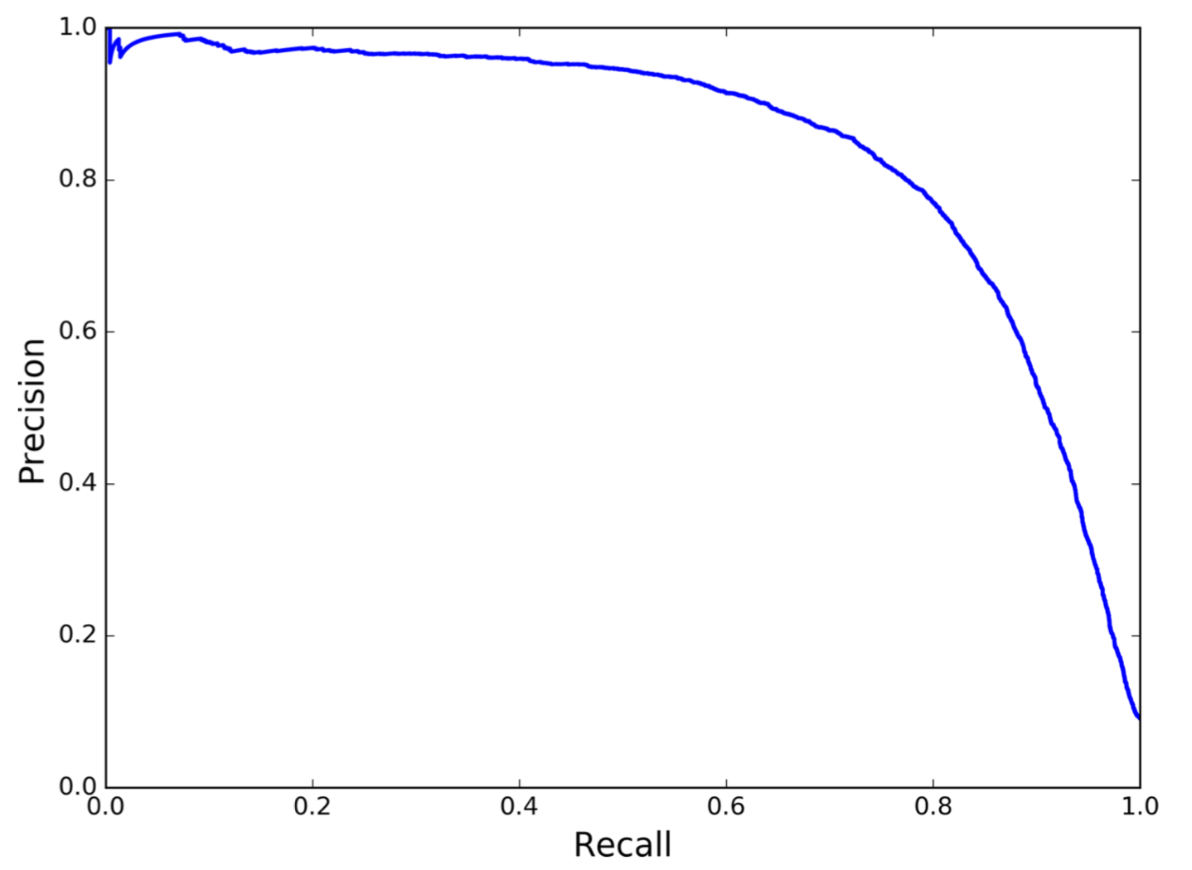
Prescision Recall Curve
Chapter 3 (O'Reilly) of Hands-On ML

Slide 7
Ture Positive Rate and False Positive Rate
Chapter 3 (O'Reilly) of Hands-On ML

Slide 8
Ture Positive Rate and False Positive Rate
TPR = TP / P
Chapter 3 (O'Reilly) of Hands-On ML

Slide 9
Ture Positive Rate and False Positive Rate
TPR = TP / P (<----- RECALL)
Chapter 3 (O'Reilly) of Hands-On ML

Slide 10
Ture Positive Rate and False Positive Rate
FPR = FP / N
TPR = TP / P (<----- RECALL)
Chapter 3 (O'Reilly) of Hands-On ML

Slide 11
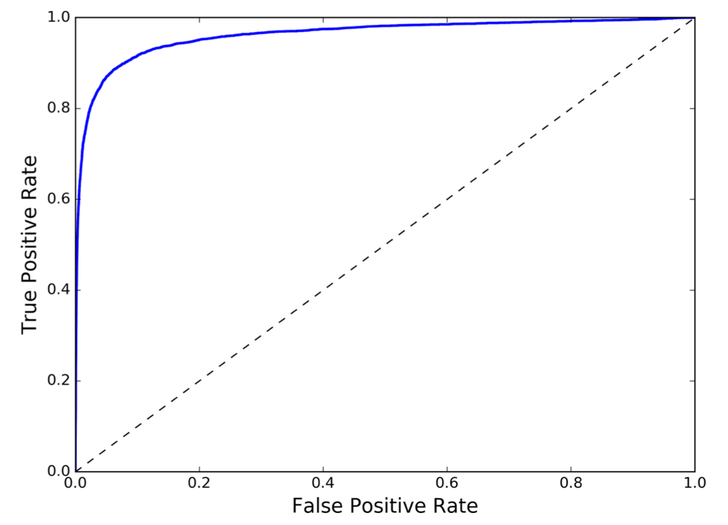
ROC Curve
Chapter 3 (O'Reilly) of Hands-On ML

Slide 12
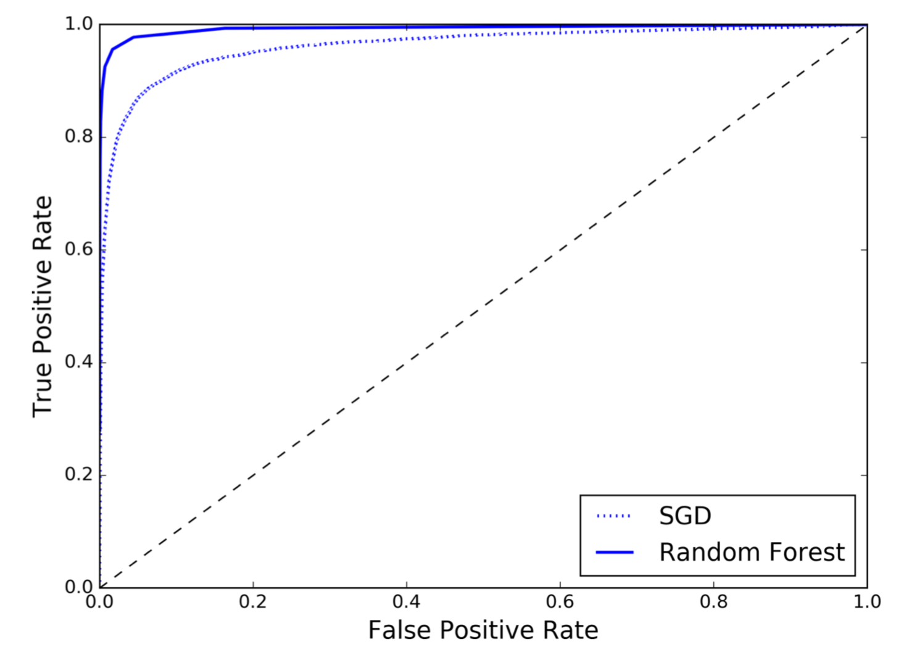
Comparing ROC Curves
Chapter 3 (O'Reilly) of Hands-On ML

